Slide 1
MULTI FUNCTION ROBOT CAR
Project Guide:
Ms.V.Sri Lakshmi
Assistant Professor
Presented by:
S.Swathi (19X41A0446)
Ch.Raghunadh (19X41A0409)
N.Jeswitha (19X41A0434)
V.Sai Kumar (19X41A0452)

Slide 2
CONTENTS
Abstract
Introduction
Block Diagram
Components
Applications
Results
Future work

Slide 3
ABSTRACT
Robots were originally developed for industrial use, such as in factories, but a new generation of robots has been designed to achieve symbiosis with humans. This Robot car can perform four operations. The four functions are Bluetooth controller, Obstacle Avoider, Line follower and Human followe Robot Car. Arduino based bluetooth module is going to used to control this project with the help of a mobile applictaion.Ultrasonic sensor module is use to control the obstacles avoiding function.Ultrasonic sensor is also used to follow the human.IR sensor is used for the functionality of line folling.All these functionalities are controlled by using the Arduino microcontroller.

Slide 4
INTRODUCTION
Robotic devices are becoming increasingly used in a variety of contexts to perform tasks and solve problems.
Robotics is a rapidly growing field, as technological advances.
The concept of creating robots that can operate automatically.
Robots are in direct contact with the physical world and they have often been used to perform repetitive tasks instead of human beings.
It saves humans time and perform work easily and fastly.
Robots can increase productivity, efficiency, quality and consistency of products.
Unlike humans, robots don't get bored. Until they wear out, they can do the same thing again and again. They can be very accurate and perfect.

Slide 5
Block Diagram
Power Supply
Motors and wheels
Ultrasonic sensor
ARDUINO UNO
Motor Driver Shield
IR Sensor
Servo Motor
Bluetooth module

Slide 6
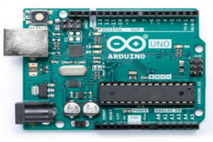
ARDUINO UNO
ARDUINO UNO is a low-cost, flexible, and easy-to-use programmable open-source microcontroller board that can be integrated into a variety of electronic projects.
The Arduino Uno is an open-source microcontroller board based on the Microchip ATmega328P microcontroller and developed by Arduino.cc
The board has 14 Digital I/O pins, 6 Analog I/O pins, and is programmable with the Arduino IDE (Integrated Development Environment), via Arduino cable.
Arduino uno

Slide 7
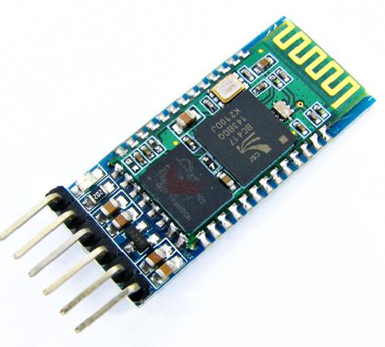
HC05 BLUETOOTH MODULE
HC-05 is a Bluetooth module which is designed for wireless communication. This module can be used in a master or slave configuration.
It has 6 pins.
Key/en, Vcc, GND, Tx, Rx, State.
Power Supply : 3.3V to 6V.
Range : 10m.
Bluetooth module

Slide 8
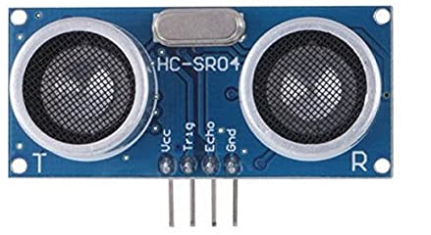
ULTRASONIC SENSOR
An ultrasonic sensor is an electronic device that measures the distance of a target object by emitting ultrasonic waves, and converts the reflected waves into an electrical signal.
Ultrasonic sensors have two main components: the transmitter and the receiver.
It has 4 pins.
Vcc,Gnd,Trig,Echo.
Range : 2cm to 400cm
Ultrasonic sensor

Slide 9
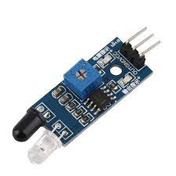
IR SENSOR
An infrared (IR) sensor is an electronic device that measures and detects infrared radiation in its surrounding environment.
When an object comes close to the sensor, the infrared light from the LED reflects off of the object and is detected by the receiver.
It has 3 pins.
Vcc,Gnd,OUT.
Range: 40 to 50cm at indoors and 15 to 20cm at Outdoors.
IR Sensor

Slide 10
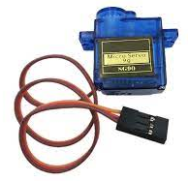
SERVO MOTOR
Servo motor is an electrical device which can be used to rotate objects (like robotic arm) precisely.
Servo motor consists of DC motor with error sensing negative feedback mechanism. This allows precise control over angular velocity and position of motor.
It is a closed loop system where it uses negative feedback to control motion and final position of the shaft.
It is not used for continuous rotation like conventional AC/DC motors.
It has rotation angle that varies from 0° to 180°.
Servo motor

Slide 11
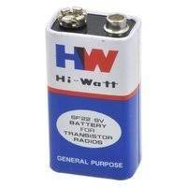
BATTERY
An electric battery is a source of electric power consisting of one or more electrochemical cells with external connections for powering electrical devices.
When a battery is supplying power, its positive terminal is the cathode and its negative terminal is the anode.
The terminal marked negative is the source of electrons that will flow through an external electric circuit to the positive terminal.
Battery

Slide 12
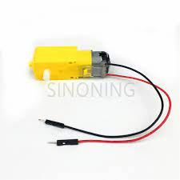
TT GEAR MOTORS
These durable plastic gearbox motors also known as 'TT' motors .
A gear motor is an all-in-one combination of a motor and gearbox.
The addition of a gear head to a motor reduces the speed while increasing the torque output.
The main purpose is to allow the reduction from an initial high speed to a lower one without negatively affecting the mechanism.
TT Gear motor

Slide 13
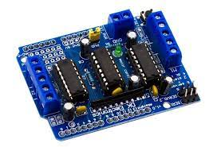
L293D MOTOR DRIVER SHIELD
A motor is an electronic device that helps convert electrical energy into mechanical energy. Therefore, a motor driver allows you to conduct automatic works using electrical power.
A motor driver showcases itself as an interface between the motor and the microcontroller.
The reason is that the microcontroller and the motor work on different ranges of voltages. The engine will use up a higher current level than the microcontroller.
Motor driver

Slide 14
APPLICATIONS
Bluetooth can control smart home systems, cars
Obstacle avoiding robots can be used in almost all mobile robot navigation systems.
They can be used for household work like automatic vacuum cleaning.
They can also be used in dangerous environments, where human penetration could be fatal.
Human following is a technique used by robot and autonomous vehicles to follow a human within a specific range.
The human follower robot can help us in domestic environment as well as in an industrial area.
These robots can be used as automated equipment carriers in industries replacing traditional conveyer belts.

Slide 15
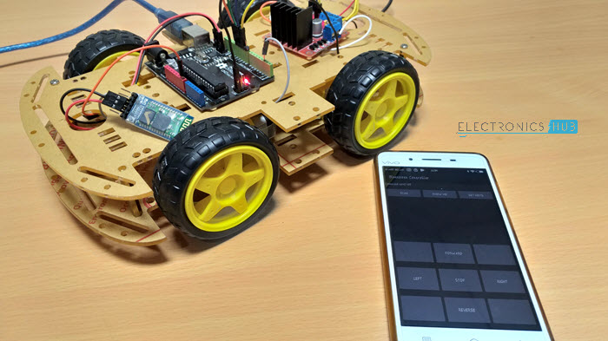
RESULTS
The bluetooth robot car is controlled by Arduino with the help of mobile commuication

Slide 16
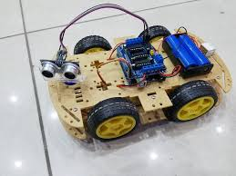
RESULTS
The obstacle avoiding robot car

Slide 17
FUTURE WORK
Line follower:
The concept of the line follower robot is related to light. Here, we use the behaviour of light on the black and white surface. The white colour reflects all the light that falls on it, whereas the black colour absorbs the light.
Human follower:
Human Follower Robot using Arduino UNO can follow a human effectively. Ultrasonic sensor like an eye is used here to detect human being. The sensor is used to measure the distance of the human being from the robot. Arduino UNO is used to navigate the robot towards human.

Slide 18
THANK YOU

